Slide 1
Some Drawbacks of ViT (part of defend and attack for ViT due to lack of resource!)
Ziqian Lin

Slide 2
Transformer was firstly proposed in 2017, then dominating the field of NLP. Recently, transformer networks have begun to be explored in the field of CV and drawn quite a lot of attentions. So the attention is drawing our attention! Here we explore the attack results and attention visualization results for this project.

Slide 3
procedure
PGD Attack
Attention Attack
Attention Visualization results
Conclusion

Slide 4

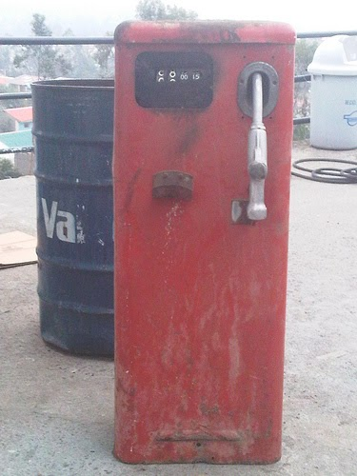
PGD Attack
Grad = from loss (maximum)
Setting:
iteration = 10
step_size = 0.01 (image in [-1, 1])
perturbation range = 0.05/2 = 2.5%
ViT_base = trained on IMAGENET
input = 3*384*384 output = 1000
dataset = imagenette/10 categories/select 20 val images per category
Results:
prediction change rate = 200/200 =100%

Slide 5
Attention Attack
Grad = from loss and attention map (from rollout)
Setting:
iteration = 100
step = 0.005
perturbation range = 0.1/2 = 5%
ViT_base = trained on IMAGENET
input = 3*384*384 output = 1000
dataset = imagenette/10 categories/select 10 val images per category
Results maintain label rate: 1.0
average sim: tensor(0.3905, device='cuda:0', grad_fn=<DivBackward0>)

Slide 6
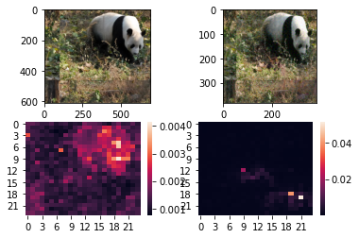
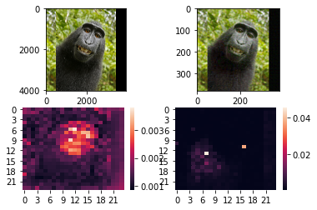
(CEloss(model(transimg), label) + lamda*Similar(attack_A[0,1:].reshape([-1]), target_A[0,1:].reshape([-1]))).
backward()
cos=0.3825
confident 99.51 => 99.86
cos=0.4177
confident 89.95 => 98.69

Slide 7
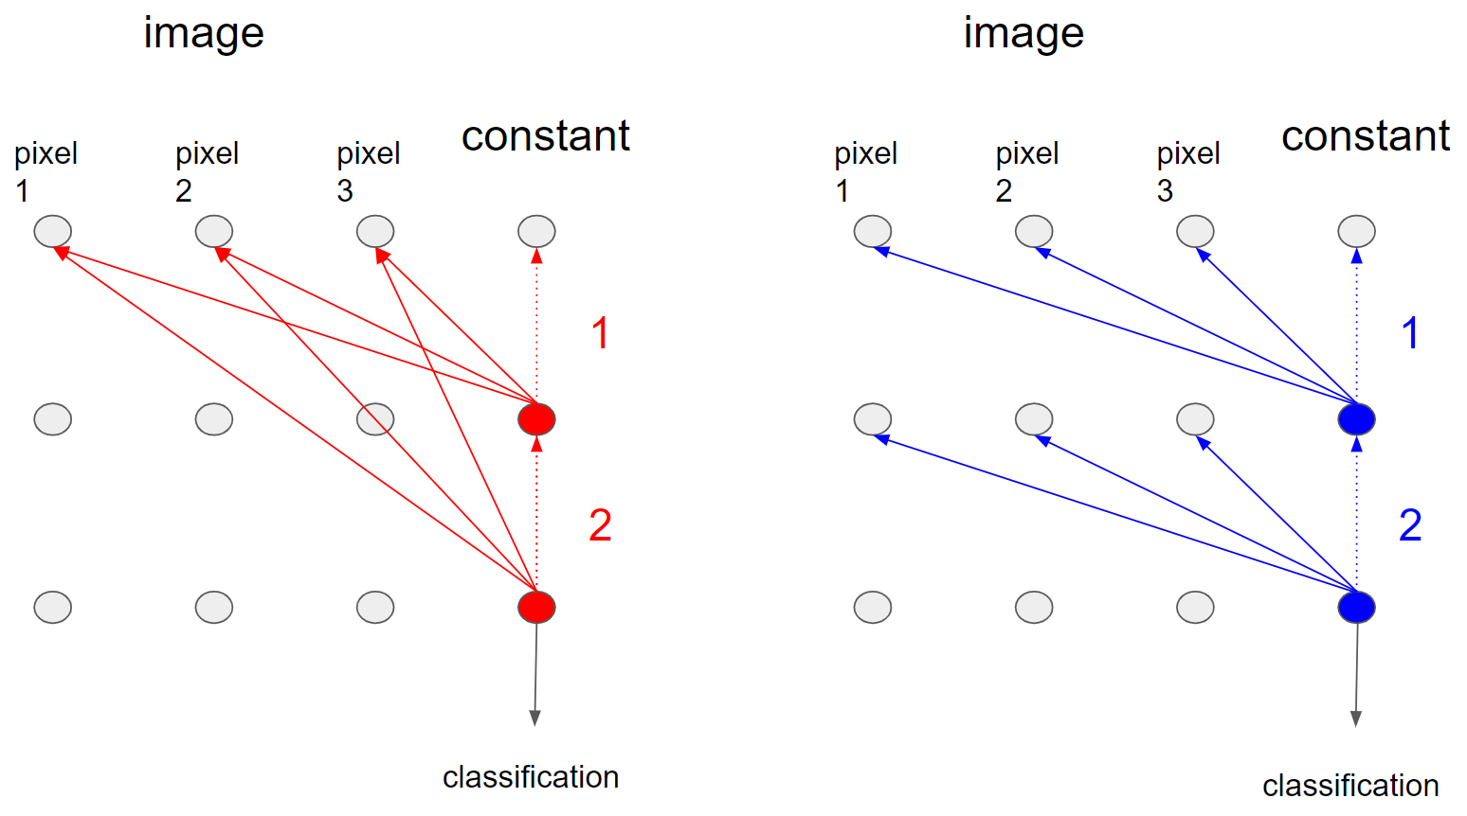
Attention Visualization results

Slide 8
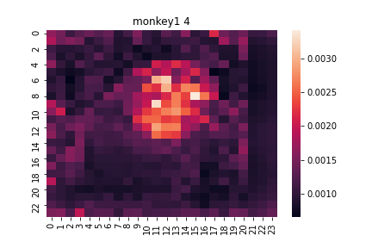
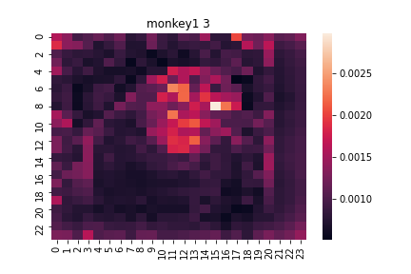
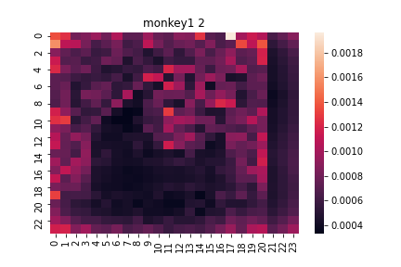
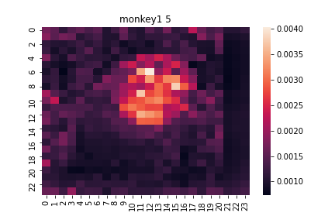
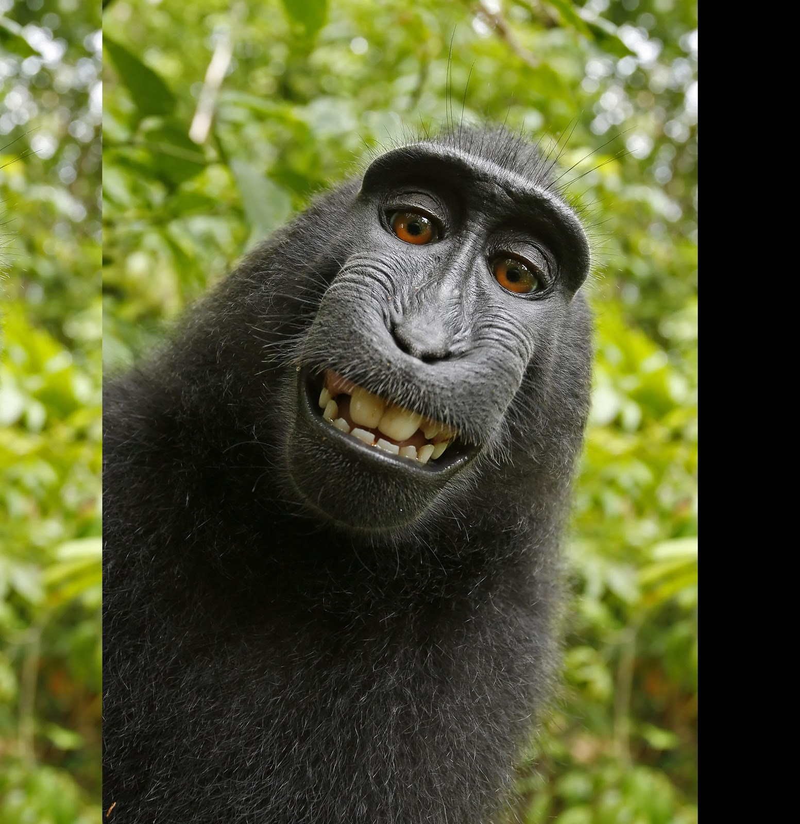
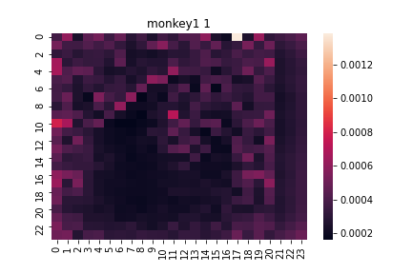
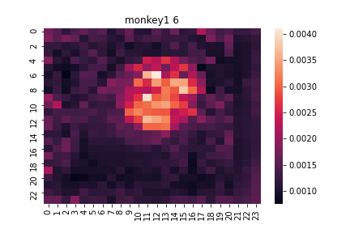
A3
A4
layer 1-6
seems good
A2
A5
A1
A6

Slide 9
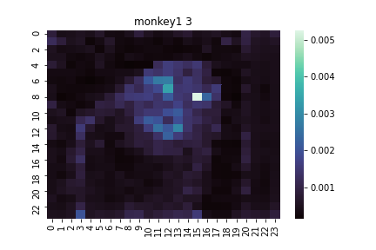
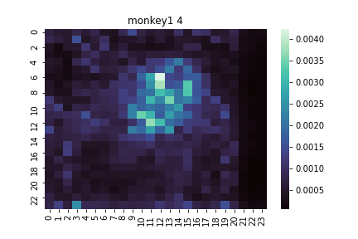
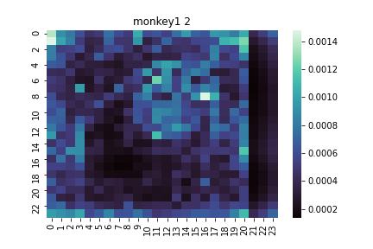
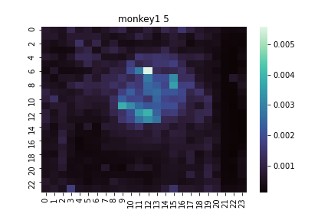
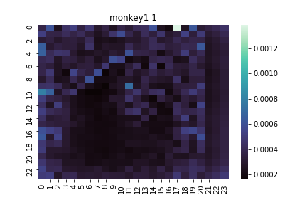
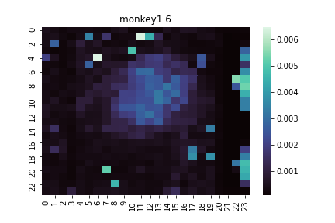
A3
A4
layer 1-6
seems good?
A2
A5
A1
A6

Slide 10
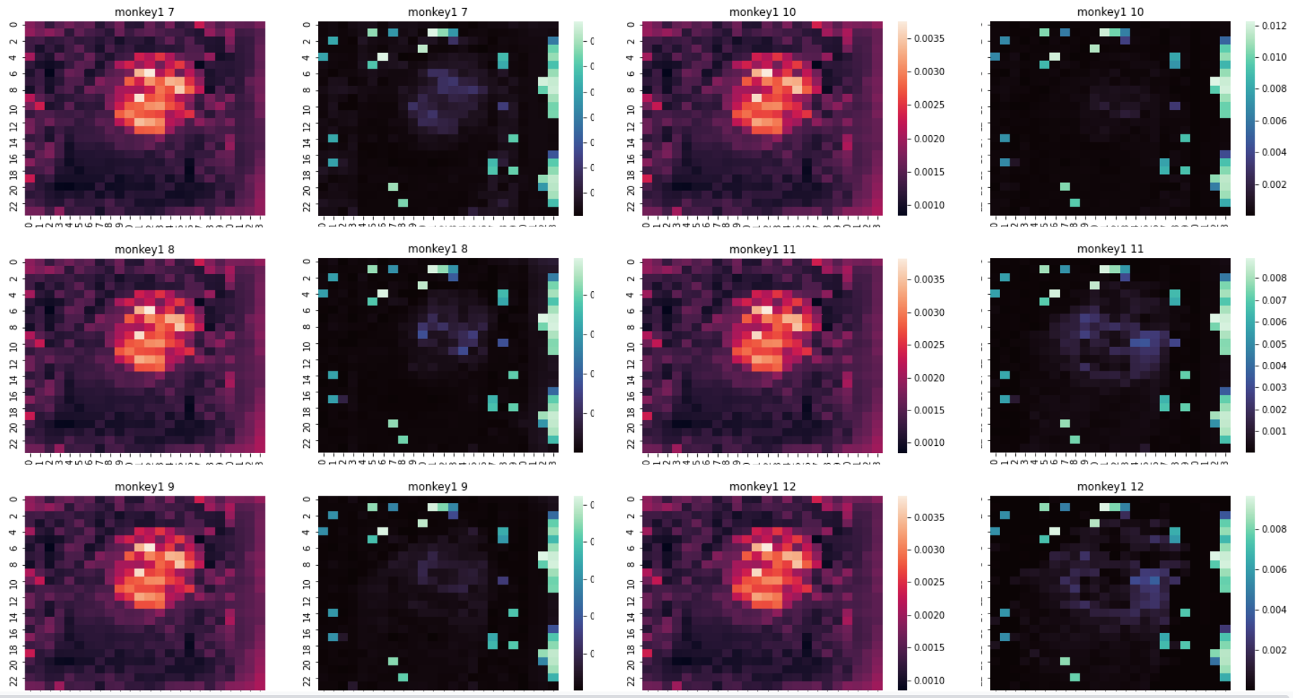
layer 7-12
omg wut’s this!?

Slide 11
Conclusion
Though transformer show amazing results in CV, it can be easily attacked. Meanwhile, the instinct interpretable attention mechanism of transformer is questionable.
A potential interesting paper: DeepViT https://arxiv.org/pdf/2103.11886.pdf

